Slide 1
Sales Prediction

Slide 2
Objective of the project:
Build a predictive model to find out the sales of each product at a particular store.
Using Linear Regression, Decision Tree, Ridge Regression and Random Forest Predictors.
To find the best optimal solution with the least RMSE(Root mean square error),i.e.,the best predictor.

Slide 3
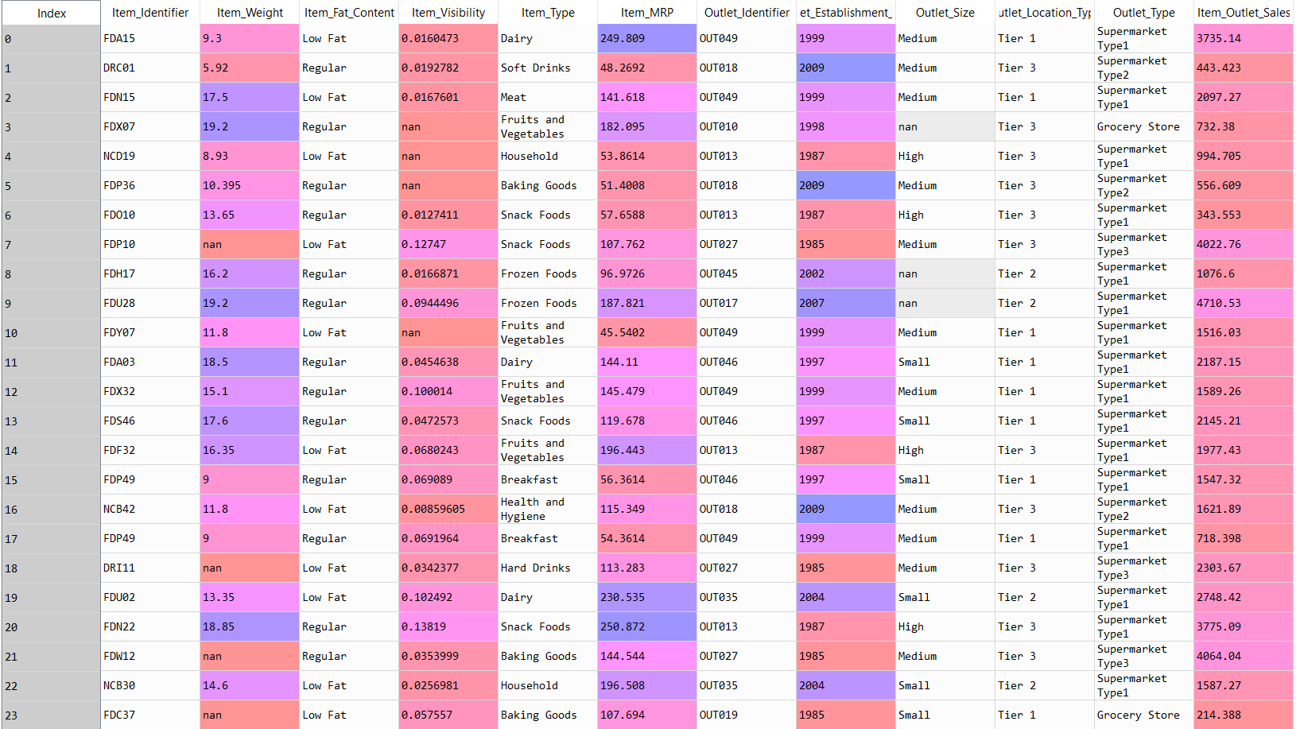
Dataset Used

Slide 4
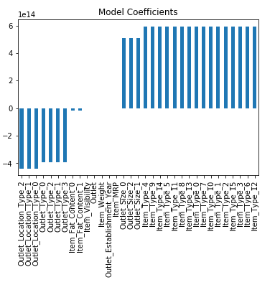
Linear Regression
Estimates the relationship between one dependent variable with one or more independent variable.
Simplest form of the regression equation is defined by the formula y = c + b1*x1+b2*x2+…., where y = estimated dependent variable score, c = constant, bi = regression coefficient, and xi = score on the independent variable.
Performance of the algorithm is calculated by finding the root mean square error.
RMSE : 1128

Slide 5
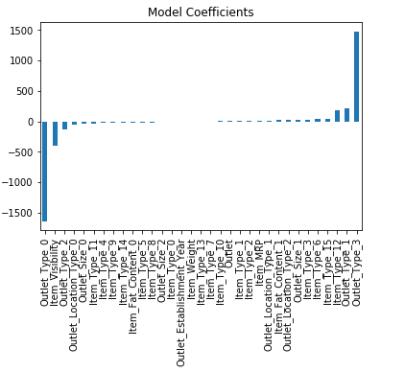
Ridge Regression
solves a regression model where the loss function is the linear least squares function and regularization is given by the l2-norm.
The loss is compensated by the sum of square of penalty.
This is done to reduce the computation time and complexity of the problem.
RMSE: 1130

Slide 6
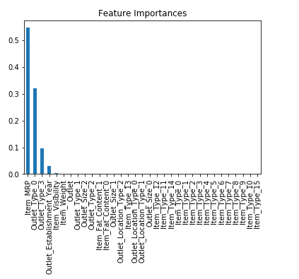
Decision Tree Regression
Used to predict a target by learning decision rules from features.
Builds regression models in the form of a flowchart-like tree structure.
Breaks down a dataset into smaller subsets while at the same time an associated decision tree is incrementally developed.
Accuracy measured in terms of mean-squared-error of the predictor.
RMSE : 1059

Slide 7
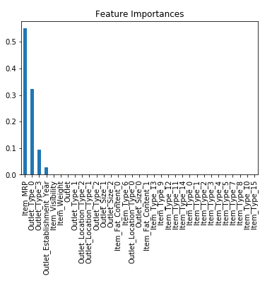
Random Forest Regression
Fits a number of classifying decision trees on various sub-samples of the dataset.
Uses averaging to improve the predictive accuracy and control over-fitting.
Parameters like n_estimators (the number of trees in the forest) and criterion(measure the quality of a split,default=“mse”) can be provided.
Accuracy measured in terms of mean-squared-error of the predictor.
RMSE: 1068

